Slide 1
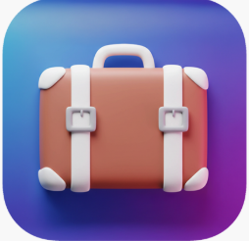
Project 1 - Product Thinking
PackBuddy
Felci Joan

Slide 2

Problem Statement:
Frequent travelers often face last-minute stress and anxiety while packing due to forgotten items, over packing, or inefficient list management. Existing solutions are either too generic or lack personalization based on destination, weather or trip type.

Slide 3


User Persona(s):
.
User Persona 1: Frequent Traveller
Name: Dinesh Kumar.
Age: 31
Occupation: Principal Engineer, Software
Location: Singapore
Travel Pattern: 2-3 work trips/month, 1 family vacation/quarter
Statement: “I shouldn’t have to waste a day before every trip trying to remember what to pack and last-min checklist hangs me”.
Goals:
Pack efficiently without forgetting essentials.
Avoid over packing.
Pain point:
Forgets items (chargers, documents, medication),
Hates last-minute packing.
Uses messy, static lists in Notes app
User Persona 2: Leisure Traveller
Name: Felci Joan
Age: 29
Occupation: Homemaker
Location: Singapore
Travel Pattern: 6 months once, Married with kid.
Statement: “I shouldn’t have to waste 2-3 days before every trip
trying to remember what to pack and buy for my family while flying back to Singapore and sometimes hard to recollect what I need in SG.”
Goals:
Save time before trips.
Create a complete family packing list with essentials for all members
Avoid last-minute packing stress and forgotten items
Pain Point:
Doesn’t have time to manually create lists.
Existing apps are not dynamic (no weather or activity-specific suggestions, cross verify my needed list)

Slide 4

Evidence of the real problem:
- User Reviews of apps like Pack Point and Packing Pro highlight limitations such as poor customization, lack of intelligent recommendations, or outdated UX.
- Online forums (e.g., Reddit r/travel, TripAdvisor) frequently feature packing-related concerns like “what to bring,” “packing checklist help,” or “forgot thing on my trip.”
- Google Reviews - PackPoint (Google Play/App Store) -3.8 to 4.5 stars — with complaints like:
    “List is too generic.”
    “Doesn’t account for weather properly.”
    “Too many ads for basic functionality.”
Industry Reports: McKinsey Travel Insights: ”Travelers are returning, but friction in travel planning —including packing—is a growing pain point.”
- Interviews with 5 frequent flyers revealed:
- 4 of 5 use Notes or spreadsheets for packing
- 3 of 5 forgot items in the last 6 months
- 100% would try an app that saved packing time intelligently

Slide 5

Brief Description :
  PackBuddy is a smart packing assistant app with AI assist that generates personalized packing checklists based on destination, weather, trip duration, and activities.
  It also enables users to save templates, set reminders, share & access to others and sync with offline & travel calendars.
  Get a AI Assist (on premium feature).

Slide 6
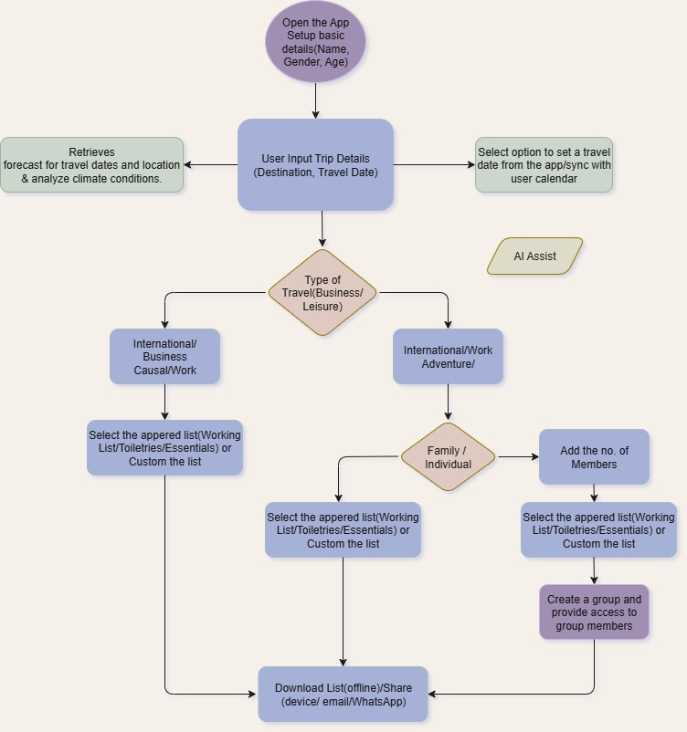
Flow Chart:
Users will be able to:
Sync the Calendar.
Customized the packing list(Add new items)
Get suggestions from AI assist(i.e Things/clothes needed for the destination)
Share / Download the list & Save for future use.
For Family trip the list can be accessibly by other via sharing link.
Set reminders.
Rich & Convenient UI.

Slide 7
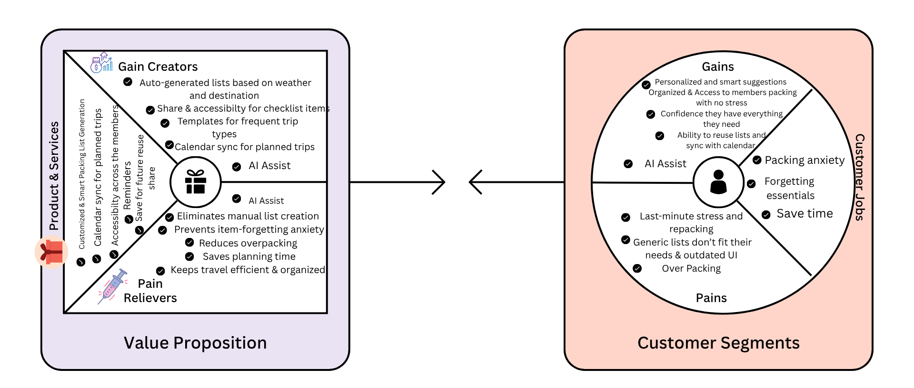
Value Proposition Canvas:

Slide 8
Test Plan:
User Validation:
Goal: Validate pain point, Prioritize features
Method: User interviews (10 travelers), Google Form survey with mockups.
Success Metric: 80%+ express frustration with packing & Top 3 features selected by 70%+.
Functional & Tech Testing:
Goal: Test MVP usability, Feature validation
Method: In-app feedback and surveys ,1-week beta with 25 users
Success Metric: 90% complete packing list successfully
Enhancement
Goal: Freemium vs Premium model
Method:, A/B test AI packing suggestions
Success Metric: 80%+ rate usefulness ≥ 4/5

